Slide 1
ClaimContact Widgets
29 August 2011
Notes:
ClaimContact Widgets - <number>
Guidewire training materials contain Guidewire proprietary information that is subject to confidentiality and non-disclosure agreements. You agree to use the information in this manual solely for the purpose of training to implement Guidewire software solutions. You also agree not to disclose the information in this manual to third parties or copy this manual without prior written consent from Guidewire. Guidewire training may be given only by Guidewire employees or certified Guidewire partners under the appropriate agreement with Guidewire.

Slide 2
Lesson objectives
By the end of this lesson, you should be able to:
  Describe the behavior of ClaimContact widgets
  Configure ClaimContact widgets
  This lesson uses the notes section for additional explanation and information.
  To view the notes in PowerPoint, choose View→Normal or View→Notes Page.
  If you choose to print the notes for the lesson, be sure to select “Print hidden slides.”
Notes:
ClaimContact Widgets - <number>

Slide 3
Lesson outline
ClaimContact widget basics
Configuring ClaimContact widgets
Notes:
ClaimContact Widgets - <number>

Slide 4
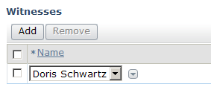

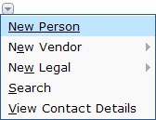



ClaimContact widgets
ClaimContactCell
ClaimContactInput
Contacts
on Claim
Contact
"Picker Menu"
Contacts
on Claim
Contact
"Picker Menu"
Widget used to either select existing contact on claim or to add contact to claim
Notes:
ClaimContact Widgets - <number>
The ClaimContactInput and ClaimContactCell widgets are special widgets designed specifically to let end users select existing contacts or create new contacts which are associated to a given claim or its subobjects. Because they have been designed for a specific purpose, they have more "built-in" functionality than a simple TypeKeyInput or RangeInput widget.

Slide 5
ClaimContact dropdowns
ClaimContactCell
ClaimContactInput
Contacts
on Claim
Contacts
on Claim
ClaimContact widget dropdowns list all contacts of given subtype (or its child subtypes) already associated to claim
Notes:
ClaimContact Widgets - <number>

Slide 6
ClaimContact picker menus
configurable
ClaimContact widgets can have picker menus
  Create new contacts
  Search for contacts or view a contact's details
Notes:
ClaimContact Widgets - <number>
A "picker" is the small gray down-turned arrow beside the picklist. It allows creating, searching for or viewing details about the referenced contact, and is specified by the ClaimContact widget’s newContactMenu attribute.
In a ClaimContact widget's picker menu, the Search and View Contact Details menu items come "automatically" with the widget, though you can hide the Search option through the showSearchInMenu attribute. The remaining menu items (the "New..." menu items) appear based on how the widget is configured.

Slide 7
Lesson outline
ClaimContact widget basics
Configuring ClaimContact widgets
Notes:
ClaimContact Widgets - <number>

Slide 8
Configuring a ClaimContact widget
Create the widget
Configure the widget's attributes
  Widget value
  Dropdown contents
  Picker menu
Notes:
ClaimContact Widgets - <number>

Slide 9
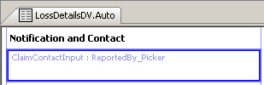
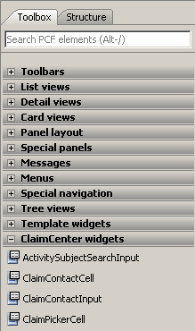
Step 1: Create the widget
Notes:
ClaimContact Widgets - <number>
The ClaimContact widget tools are located in the ClaimCenter widgets section of Studio.

Slide 10
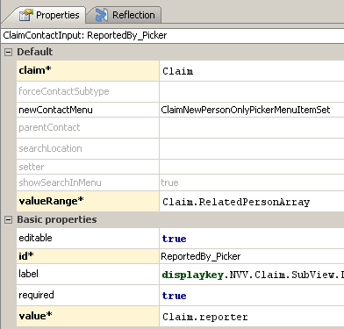

Step 2A: Configure the value attributes
contact on claim with role "reporter"
Notes:
ClaimContact Widgets - <number>
There are three attributes involved in standard configuration of a ClaimContact widget: value, valueRange and newContactMenu.
Recall that "Related to" entities have properties for each role an entity can own. The value attribute of a ClaimContact widget is set to one of these properties. When you do this, any contact selected by the widget through the dropdown or picker menu is associated to the claim and given that role. (In the example above, the ReportedBy_Picker widget is a ClaimContactInput widget whose value attribute is set to Claim.reporter and whose value is Ray Newton. Therefore, the Ray Newton contact is added to the claim and is assigned the role of "reporter".)

Slide 11
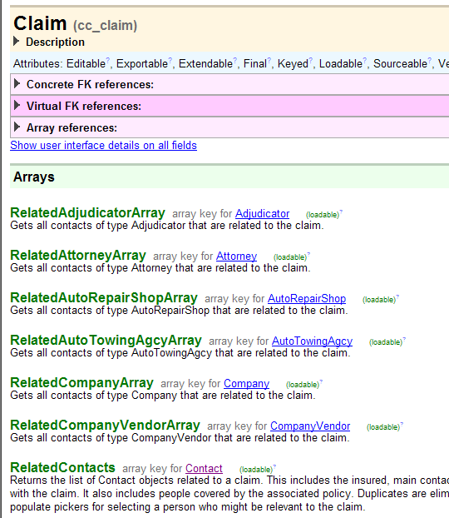
Arrays of related contacts
Claim entity has set of functions, one for each contact subtype, which return all contacts of that subtype on claim (regardless of role)
  Named Related<Subtype>
  Array
  Appear in the data dictionary as arrays
  Useful when configuring ClaimContact widgets
Notes:
ClaimContact Widgets - <number>
Examples:
aClaim.RelatedContacts returns all related contacts of type Contact (in other words, all contacts) associated to aClaim
aClaim.RelatedLawFirmArray returns all related contacts of type LawFirm associated to aClaim
aClaim.RelatedPersonArray returns all related contacts of type Person associated to aClaim

Slide 12
Step 2B: Configure the dropdown contents
Notes:
ClaimContact Widgets - <number>
The valueRange attribute determines the related contacts array used by the ClaimContact widget to display the list of contacts in the dropdown. In the example above, the attribute is set to Claim.RelatedPersonArray. This means that the contacts listed in the dropdown are all the contacts of subtype Person related to the claim.

Slide 13
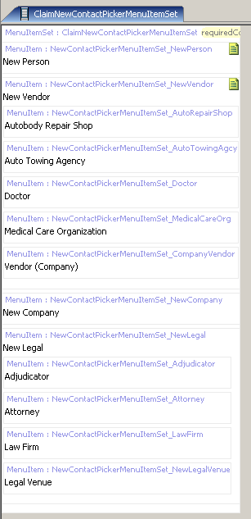
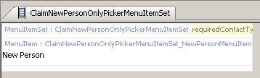

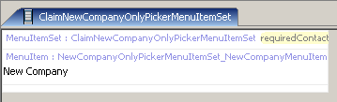

Contact picker menu item sets
ClaimNewContactPickerMenuItemSet
ClaimNewPersonOnly PickerMenuItemSet
ClaimNewCompanyOnly PickerMenuItemSet
Notes:
ClaimContact Widgets - <number>
These menu item sets are used to create new contacts of any type or of a specific type such as Person or Company.
As mentioned before, note that the "Search" and "View Contact Details" menu items do not appear in the menu item sets. These menu items are added automatically to the picker menu of any ClaimContact widget.

Slide 14
Step 2C: Identify the picker menu
Notes:
ClaimContact Widgets - <number>
The newContactMenu attribute determines which menu appears as the picker menu. In the example above, the attribute is set to ClaimNewPersonOnlyPickerMenuItemSet. This menu item set contains a single "New Person" menu item. (The Search and View Contact Details menu items are automatically assigned to any ClaimContact picker menu.)
If you leave the newContactMenu attribute value blank, then the ClaimNewContactPickerMenuItemSet (which lists all possible contacts) is used.
The base application comes with five menu item sets:
ClaimNewCompanyOnlyPickerMenuItemSet
ClaimNewContactPickerMenuItemSet
ClaimNewDoctorOnlyPickerMenuItemSet
ClaimNewPersonOnlyPickerMenuItemSet
ClaimNewRepairShopOnlyPickerMenuItemSet
You can set the newContactMenu attribute to either one of these menu item sets or one which you have configured yourself.

Slide 15
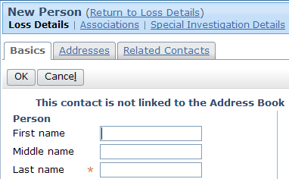
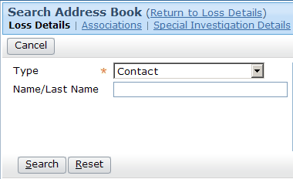
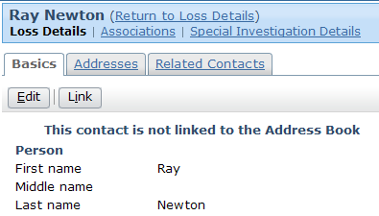
Picker menu popups
Each contact picker menu item navigates to a
popup location
NewPersonPopup
AddressBook
PickerPopup
ContactDetailPopup
If you create a custom menu, you may also need to create popups for it
Notes:
ClaimContact Widgets - <number>
If you choose to create your own ClaimContact menu item set, you must create popups as needed and configure the menu items to navigate to the popups.
Recall that the action attribute for a navigation widget takes the form of <Location>.<method>(<requiredObjectsOrValues). For example, the New Person menu item shown above has an action attribute of:
NewContactPopup.push(typekey.Contact.TC_PERSON, parentContact, claim)
This identifies that the menu item navigates to the NewContactPopup location using the push method (which lets the user navigate back to the original page after the new page is dismissed), and three values are passed: the code for the type of contact, the contact (referred to as the parent contact, as other contacts may be referenced in the popup), and the claim.

Slide 16

Restricting a picker from creating new contacts
BlankNewContactMenuItemSet
  Provides Search and View Contact Details only
  Prevents users from creating new contact
Notes:
ClaimContact Widgets - <number>
If you want to display Search and View Contact Details as the only options, specify BlankNewContactPickerMenuItemSet() in the newContactMenu field. ClaimCenter will not display any new contact options such as "New Person", "New Vendor", and so on.

Slide 17

Summary: ClaimContact widget configuration
Notes:
ClaimContact Widgets - <number>

Slide 18
Lesson objectives review
You should now be able to:
  Describe the behavior of ClaimContact widgets
  Configure ClaimContact widgets
Notes:
ClaimContact Widgets - <number>

Slide 19
Review questions
Name two functions which return contacts and are listed in the data dictionary as if they were properties.
If you wanted to configure
this widget so that it listed
and created only contacts
of subtype doctor, what
would you need to do?
What do you need to do to a ClaimContact widget so that the "Search" and "View Contact Details" options appear in the picker menu?
Notes:
ClaimContact Widgets - <number>
Answers
1. Possible answers: Any of the "role" functions on the "Related To" entities, such as Claim.reporter or Exposure.claimant; any of the related contact subtype arrays on claim, such as RelatedContactArray, RelatedCompanyArray, or RelatedAdjudicatorArray.
2. First, you would need to configure the value of the widget so that it accessed the RelatedDoctorArray. Then, you would need to create a new picker menu item set specific to doctors (perhaps called ClaimNewDoctorOnlyPickerMenuItemSet) to be used for the picker dropdown.
3. The "Search" option is controlled by the “showSearchInMenu” property. "View Contact Details" options are inherently part of a ClaimContact widget's picker menu.

Slide 20
Notices
Copyright © 2001-2011 Guidewire Software, Inc. All Rights Reserved.
Guidewire, Guidewire Software, Guidewire ClaimCenter, Guidewire PolicyCenter, Guidewire BillingCenter, Guidewire Reinsurance Management, Guidewire ContactManager, Guidewire Vendor Data Management, Guidewire Client Data Management, Guidewire InsuranceSuite, Guidewire ContactCenter, Guidewire Studio, Gosu, Deliver Insurance Your Way, and the Guidewire logo are trademarks or registered trademarks of Guidewire Software, Inc. in the United States and/or other countries.
This material is Guidewire proprietary and confidential. The contents of this material, including product architecture details and APIs, are considered confidential and are fully protected by customer licensing confidentiality agreements and signed Non-Disclosure Agreements (NDAs).
This file and the contents herein are the property of Guidewire Software, Inc. Use of this course material is restricted to students officially registered in this specific Guidewire-instructed course, or for other use expressly authorized by Guidewire. Replication or distribution of this course material in electronic, paper, or other format is prohibited without express permission from Guidewire.
    Guidewire products are protected by one or more of the following patents: U.S. Patent No. 7,885,831; U.S. Patent No. 7,788,296.
Notes:
Introduction to Guidewire Configuration - <number>

